Slide 1
TripLens Countries Explorer Dashboard
Travel & Tourism Analytics Project
Prepared by: LOVETH ILEN

Slide 2
Business Overview
TripLens Global is a tourism and travel company focused on helping travellers access reliable country information in one centralized platform.
The project was designed to provide users with key travel insights such as:
Population
Region
Currency
Languages
Time zones
Neighboring countries
The dashboard improves travel planning by transforming raw country data into interactive and easy-to-understand visual insights.

Slide 3
Problem Statement
Travel information is often scattered across multiple platforms, making it difficult for travellers to quickly compare countries and make informed decisions.
TripLens Global needed a centralized analytics solution that could:
Integrate country data from multiple sources
Present information clearly
Support quick comparisons between countries
Improve accessibility of travel insights

Slide 4
Aim of the Project
The aim of this project was to design an interactive Power BI dashboard that provides comprehensive country-level travel insights.
The dashboard helps users:
Explore countries by region
Analyze population and area distribution
Compare currencies and languages
Understand global travel patterns
Access country information quickly and interactively

Slide 5
Key Performance Indicators
The dashboards were designed around important country-level metrics, including:
Total Population
Number of Countries Tracked
Population Density
Total Area
Regional Population Distribution
Language Diversity
Currency Distribution
These KPIs help users understand demographic and regional patterns across countries.

Slide 6
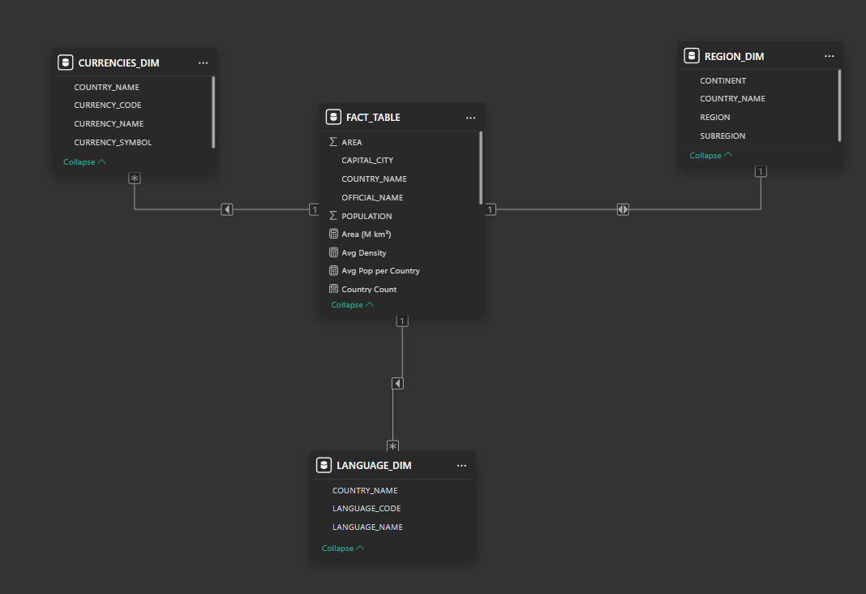
Data Modeling
Tables Used
FACT_TABLE
REGION_DIM
LANGUAGE_DIM
CURRENCIES_DIM
Modeling Approach
A star-schema model was implemented using COUNTRY_NAME relationships to support:
filtering
drill-through
interactive analysis

Slide 7
Dashboard Overview
The dashboard was divided into four analytical pages:
Global Overview Dashboard
Regional & Language Insights
Country Drill-through Analysis
Currency & Comparative Insights
Each page was designed to answer different business and travel-related questions interactively.

Slide 8
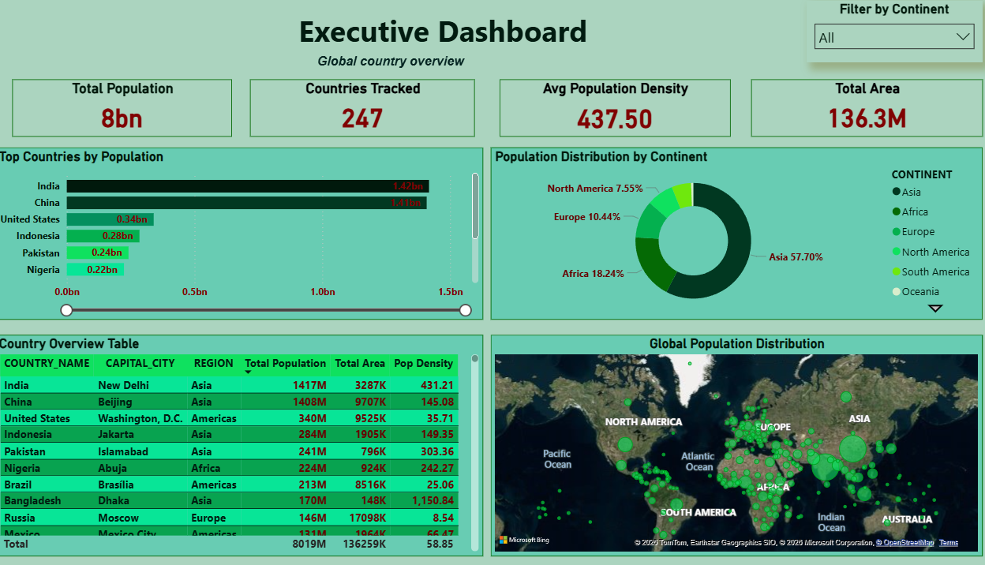
Executive Dashboard
This dashboard provides a high-level overview of global country statistics and population trends.
Key Insights
Asia holds the largest share of the global population.
India and China rank among the most populated countries.
Population distribution differs significantly across continents.
Some countries have very large land areas but relatively small populations.
Dashboard Features
KPI cards
Population comparison charts
Global map visualization
Country overview table

Slide 9
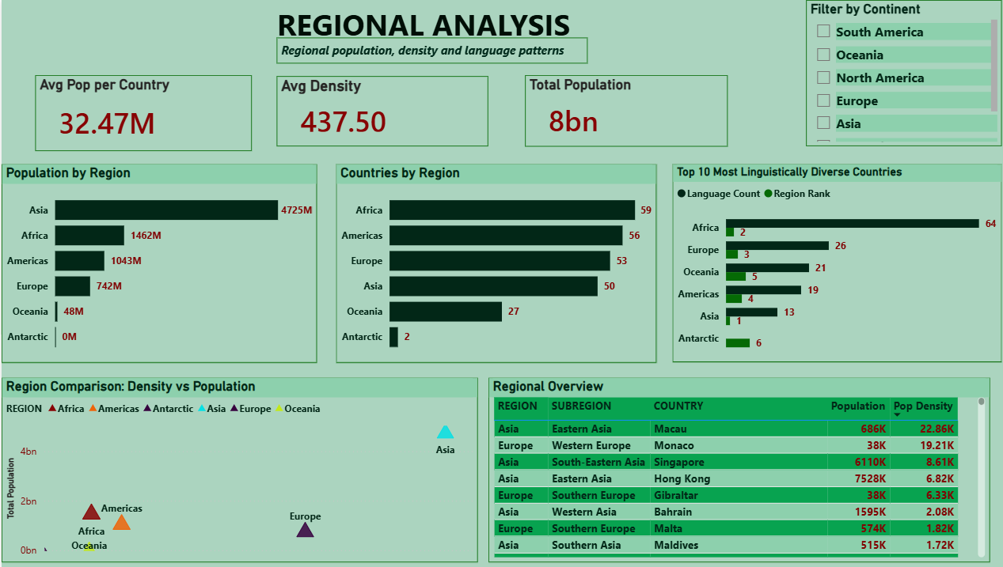
Regional Analysis
This dashboard focuses on comparing regions using population, density, and language-related insights.
Key Insights:
Africa shows strong population growth trends.
Europe contains many countries with moderate population density.
Regional language diversity varies across continents.
Population concentration is uneven across global regions.
Analysis Highlights
Population by region
Regional density comparison
Country distribution analysis
Linguistic diversity trends

Slide 10
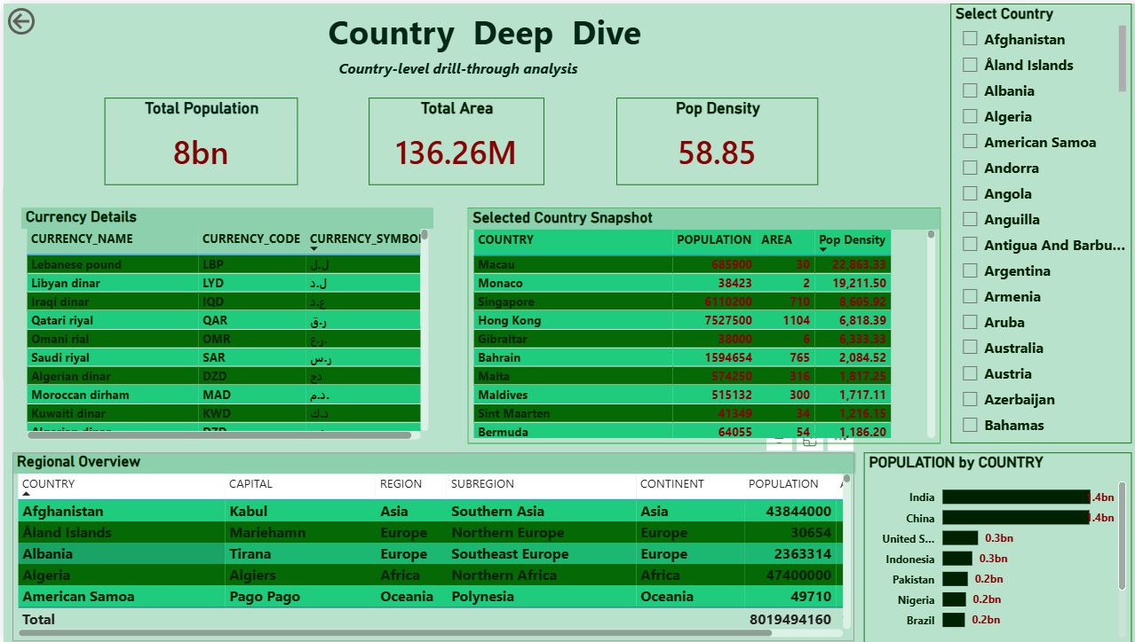
Country Deep Dive
This page allows users to explore detailed information about individual countries.
Key Insights
Countries differ greatly in population density and area size.
Some countries share common currencies and regional characteristics.
Drill-through functionality improves interactive exploration.
Dashboard Features
Country-level KPIs
Currency information
Regional classification
Detailed country tables

Slide 11
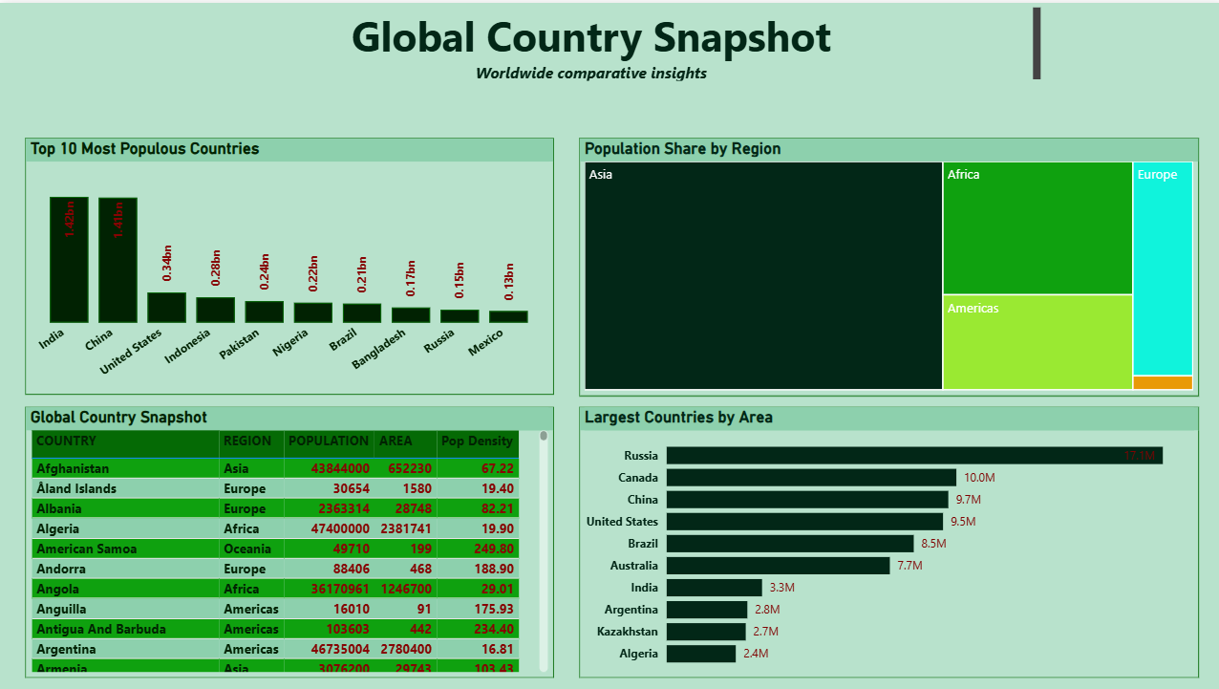
Global Insights
This dashboard provides broader analytical insights into global population and regional patterns.
Key Insights
Population is highly concentrated in a few major regions.
Density patterns vary significantly across continents.
Smaller regions contribute less to global population share.
Dashboard Features
Treemap visualization
Comparative analysis
Regional breakdown exploration

Slide 12
Analysis & Business Impact
The dashboard provides an interactive platform for analyzing global travel data efficiently.
Business value includes:
Faster access to country information
Better travel planning support
Improved user experience
Easier country comparison
Centralized travel intelligence
The project also demonstrates how data visualization can transform raw data into actionable insights.

Slide 13
Recommendations
To improve the platform further, TripLens Global can:
Integrate real-time tourism data
Add weather and travel safety analytics
Include tourism spending trends
Introduce predictive travel recommendations
Expand dashboard personalization features

Slide 14
Conclusion
The TripLens Countries Explorer project successfully transformed raw country data into an interactive and user-friendly analytics solution.
The dashboards provide:
centralized country insights
regional comparisons
interactive country exploration
travel-focused analytics
The project demonstrates how data visualization and analytics can support better travel planning and improve user decision-making.

